Slide 1

Retail Analytics Trends
Big Data Processing and Application
Shakib Ibna Shameem (2307673)
Akash Sinha Bappy (2307938)
K H M Burhan Uddin (2307264)
Mitun Paul (2307325)

Slide 2
Introduction to Big Data in Retail
Big Data in Retail
Importance
Big Data Tools
Huge records generated everyday
Massive volume of structured and unstructured data from various sources.
Essential for analyzing trends, customer behavior
Enhancing operational efficiency.
Parallel processing of multiple sources of data
Process as stream

Slide 3
Objectives of the Project
Apply Big Data Tools
Descriptive Analysis
Predictive Analysis
Using pySpark for parallel processing
MLib for predictive analysis
Exploring patterns and trends in historic data
Setting future objectives
Performance measurements
Inventory stock prediction
Sales forecasting

Slide 4
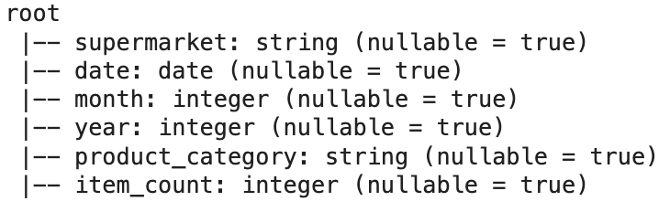
Dataset
Provides a comprehensive view of supermarket prices, enabling analysis of pricing trends, unit costs, and brand presence across various categories.
Source: https://www.kaggle.com/datasets/willianoliveiragibin/retail-analytics-trends

Slide 5
Exploratory Data Analysis

Slide 6
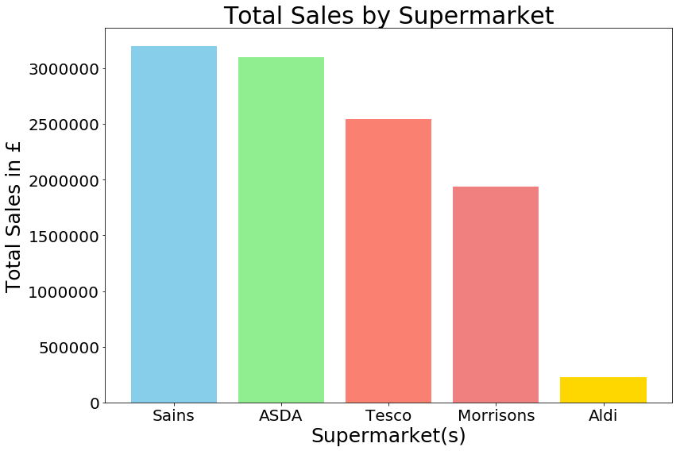
Total Sales by Supermarket

Slide 7
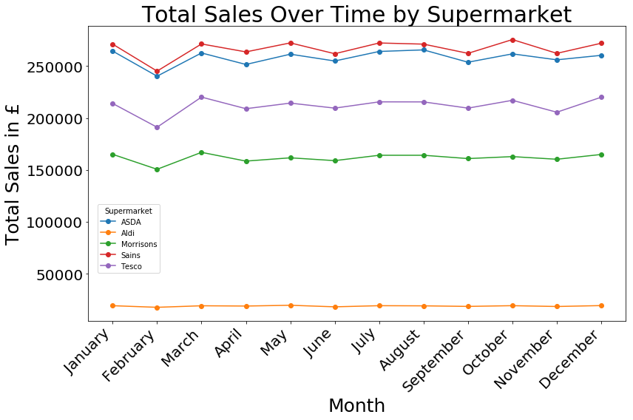
Sales by Month

Slide 8
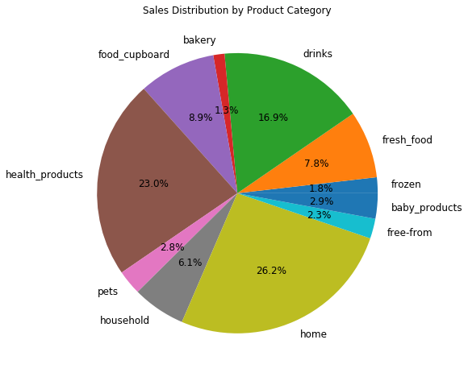
Sales Distribution by Product Category

Slide 9
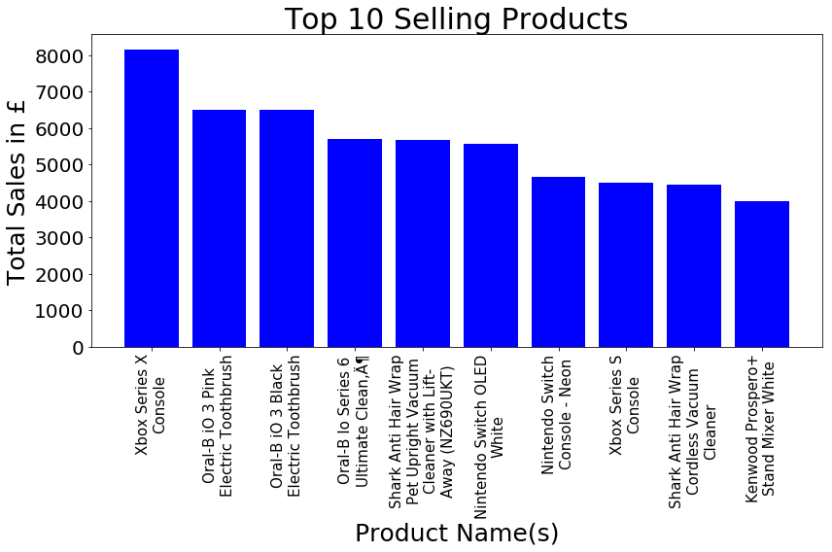
Top Sales

Slide 10
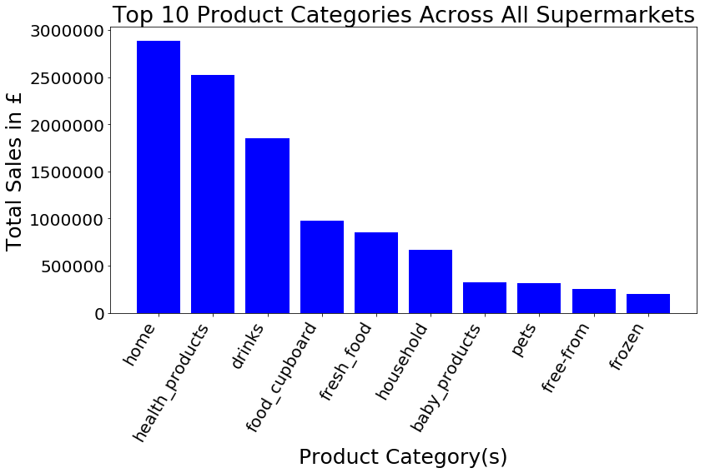
Top Sales by Category

Slide 11
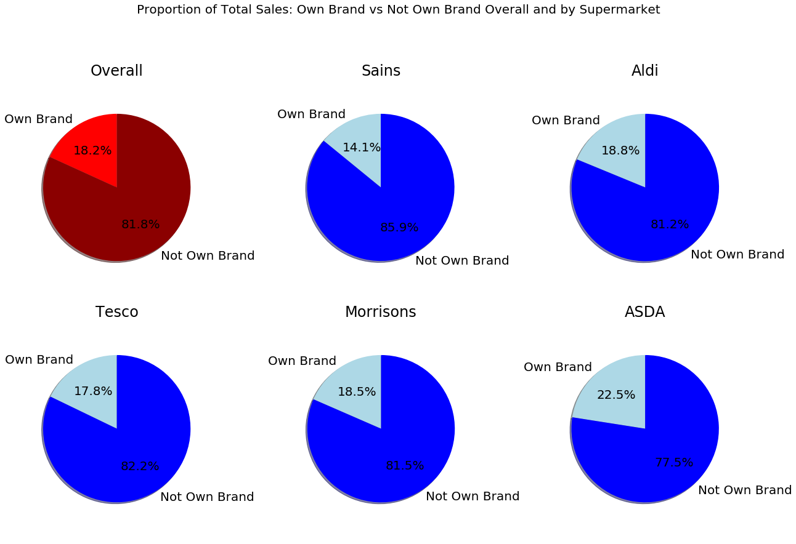
Own vs other brands sell across super markets

Slide 12
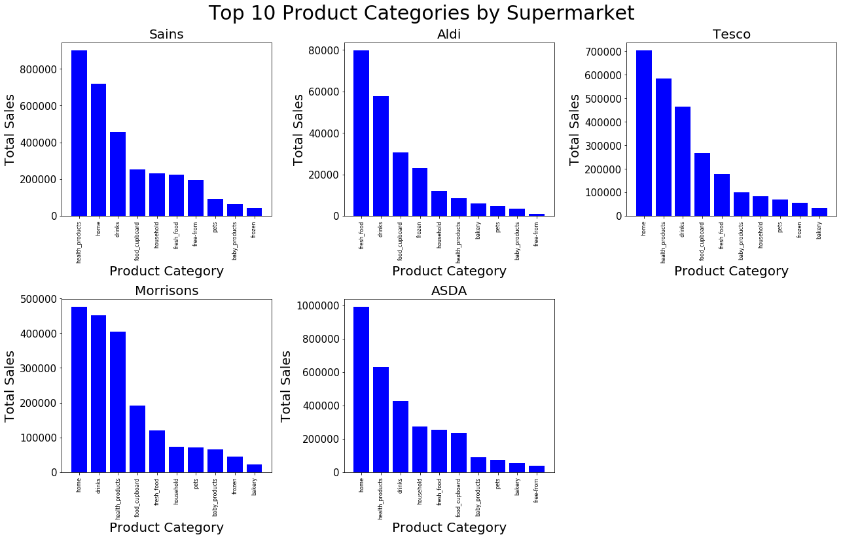
Product Categories by Super Market

Slide 13
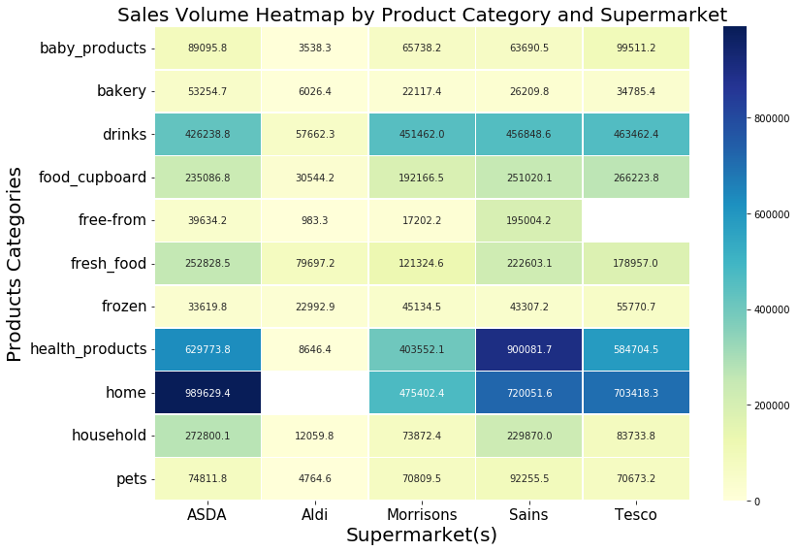
Product Categories by Super Market

Slide 14
Predictive Data Analysis

Slide 15
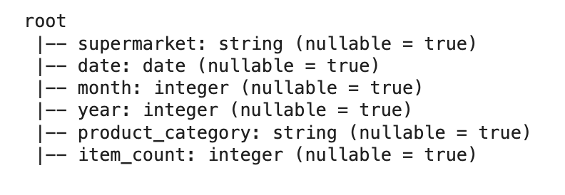
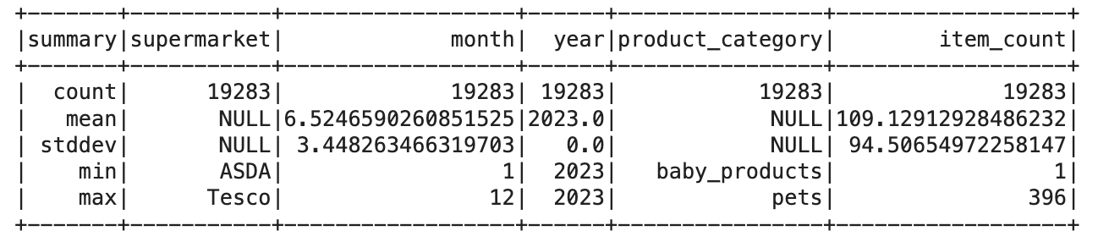
Data Processing
Aggregation

Slide 16
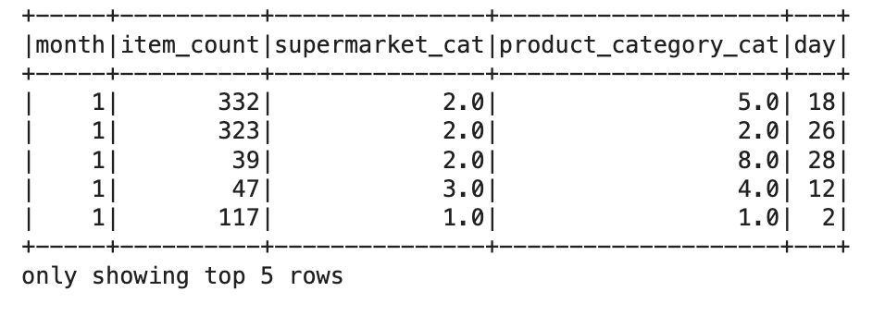
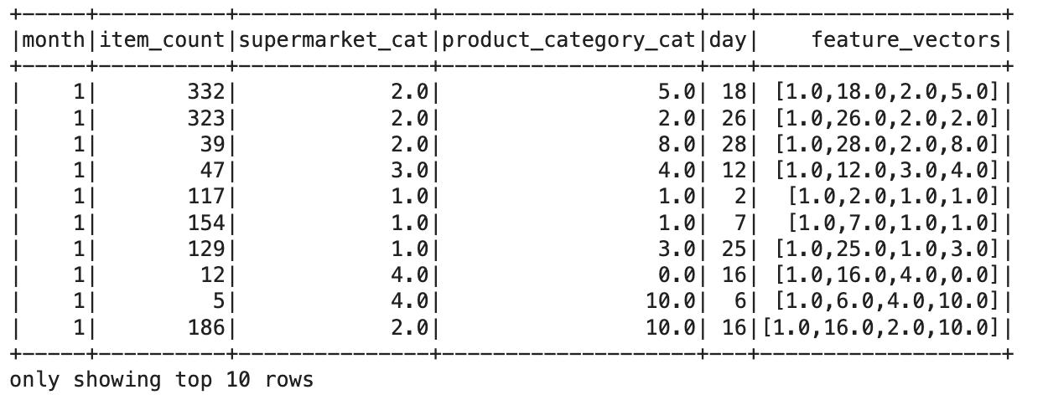
Dataset Processing
Label Encoding & Features Vectors

Slide 17
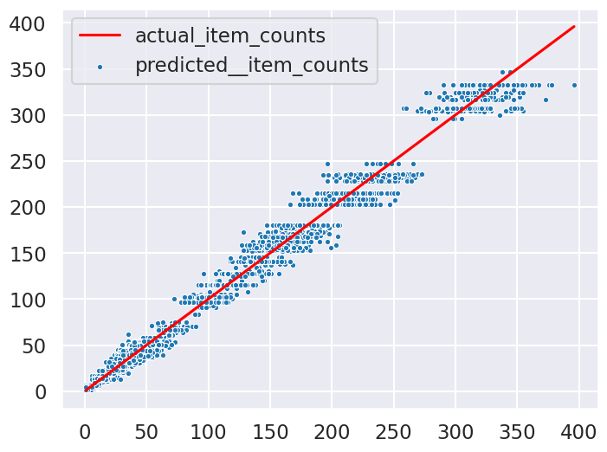
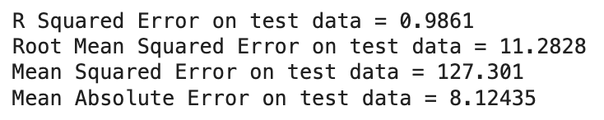
Result

Slide 18
Thank You

